Slide 1
MODEL BUILDING
ANGEL THU DO

Slide 2
SUMMARY
The target variable is influenced by three key target variables:
  Account Quality: Captured by 19 predictor variables (P1-P19)
  Seasonal Effect: Increased target rate in January and February
  Macroeconomic Trends: Time-varying effects on target rate
Five different models are built and trained: Logistic Regression, Random Forest, Histogram-based Gradient Boosting (HistGradientBoosting), LightGBM, and XGBoost.
XGBoost is the best model

Slide 3
MODELING APPROACH
1. Problem Type
  Binary classification: Predict the binary response variable target.
2. Data Handling
  Data Merge: 6 CSV files merged into a single dataset.
  Temporal Split:
    Build set (Date_ym < 2022-05) → train (80%) / validation (20%)
    Hold-out set (Date_ym >= 2022-05) → test set → final evaluation
  Segmented evaluation: Performance analyzed per segment S and over time (Date_ym).
3. Feature Engineering
  Predictor features: P1–P19 (account/macro variables)
  Temporal features: year, month, quarter, day_of_year
  Seasonal features: is_jan, is_feb, is_jan_feb
  Cyclical encoding: month_sin, month_cos to capture seasonal cycles
  Time trend: months_since_start to capture temporal evolution

Slide 4
MODELING APPROACH (cont.)
4. Modeling Pipeline
  1. Preprocessing: Scale features if needed (Logistic Regression uses StandardScaler).
  2. Model Training: Five models trained independently:
    Logistic Regression
    Random Forest
    HistGradientBoosting
    LightGBM
    XGBoost
  3. Validation: Early stopping for boosting models to prevent overfitting.
  4. Metrics Computed:
    AUC (Train, Validation, Holdout)
    Accuracy (Train, Validation, Holdout)
  5. Best Model Selection: Based on highest validation AUC.
5. Evaluation Approach
  Hold-out set evaluation: Measure performance on unseen data.
  Temporal evaluation: Track AUC and Accuracy over months.
  Segment × Time evaluation: Check model stability across customer segments and time.
  Visualization: Plots for comparison (bar plots, heatmaps, ROC, precision-recall, dashboard).

Slide 5
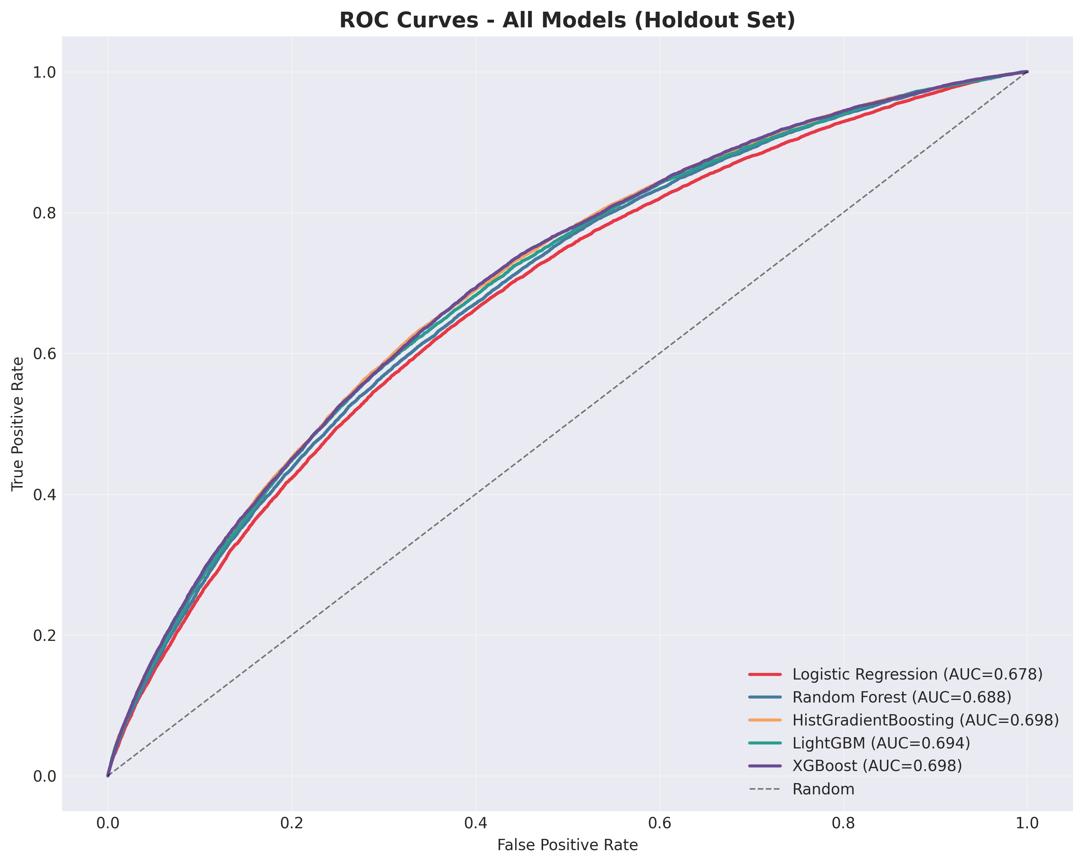
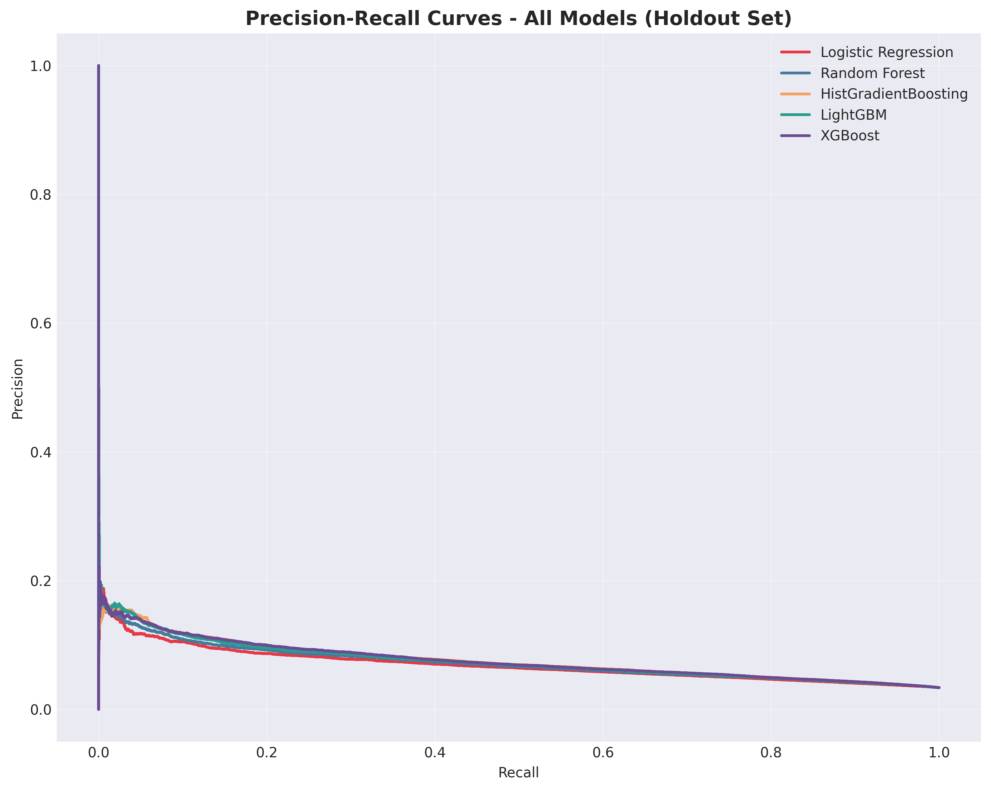
Model Comparison
For model comparison, there is not much different between models.

Slide 6
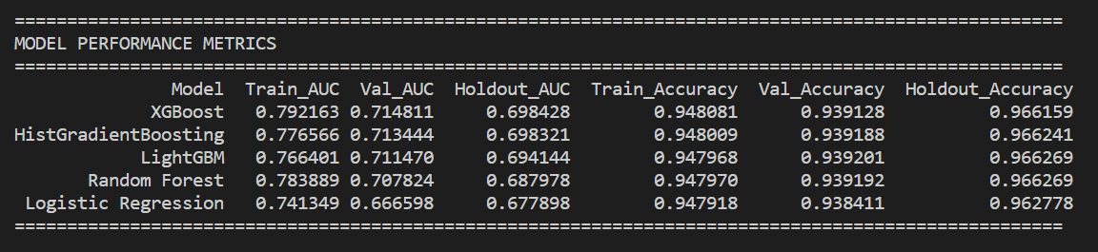
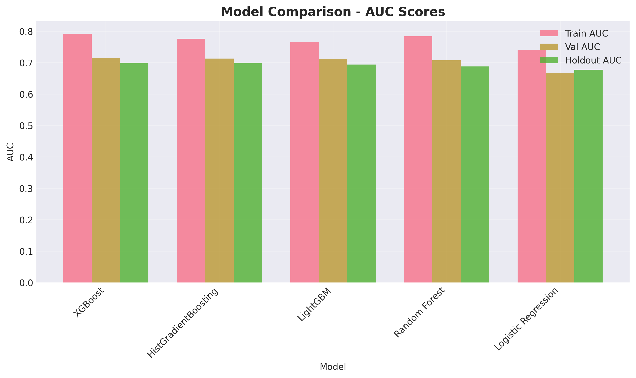
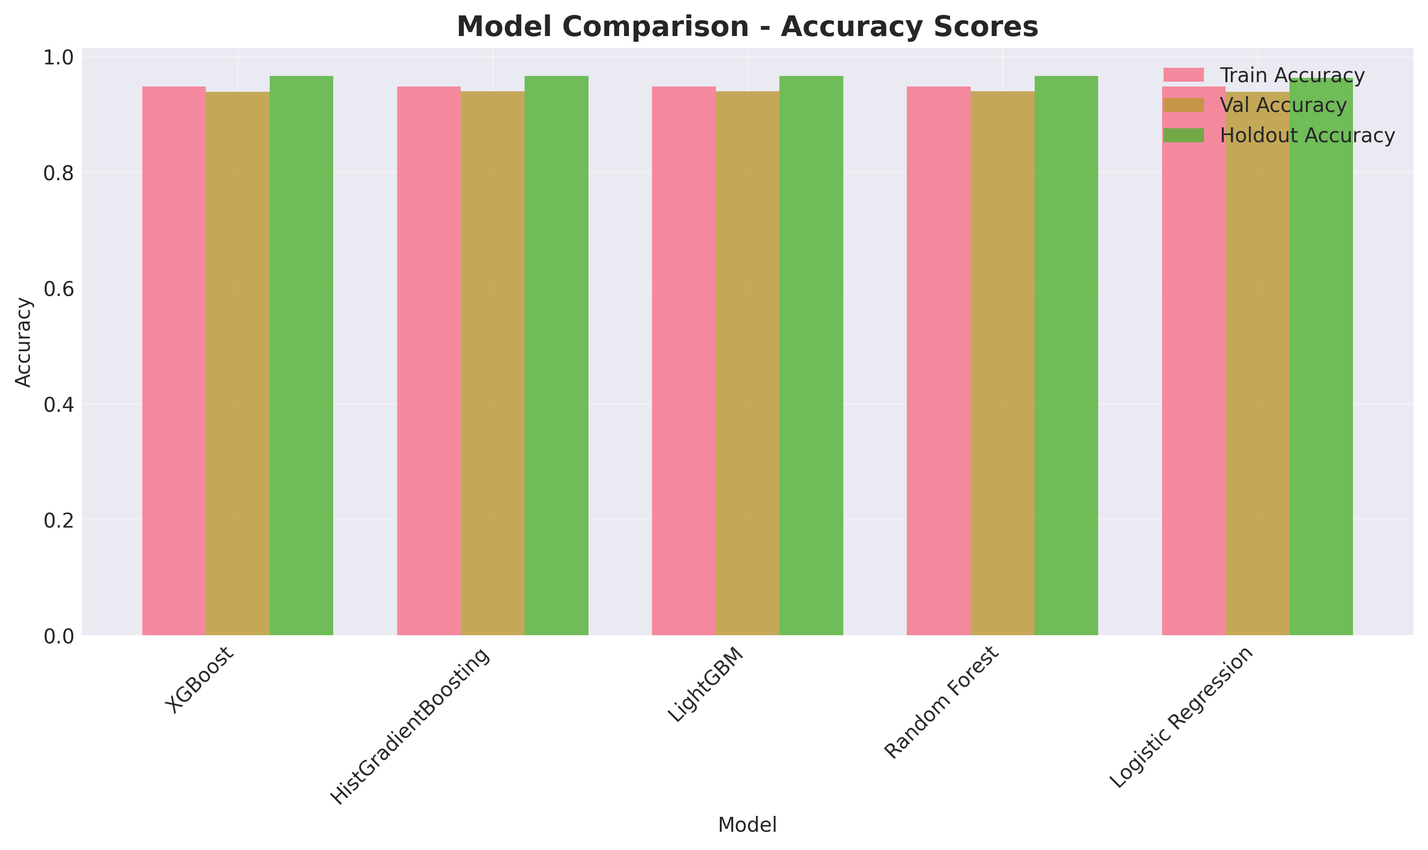
Model Comparison
Since the data is imbalance, validation AUC is preferred to evaluate model performance.
Following charts and table, XGBoost achieves the highest validation AUC (0.7148) compared to other models.
Thus, XGBoost is shown as the best model in this report.

Slide 7
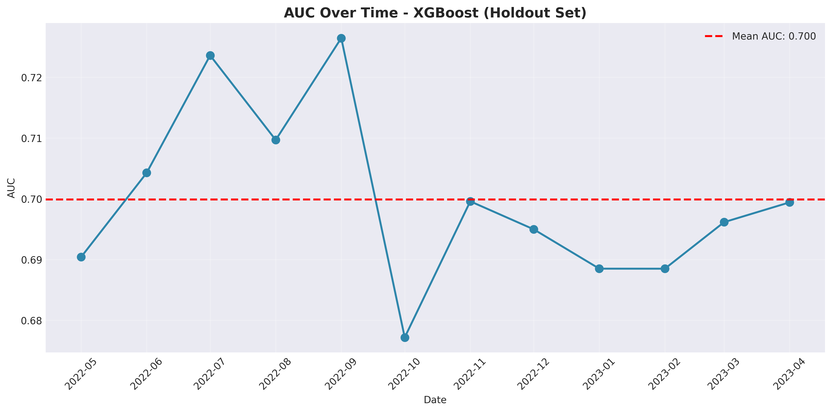
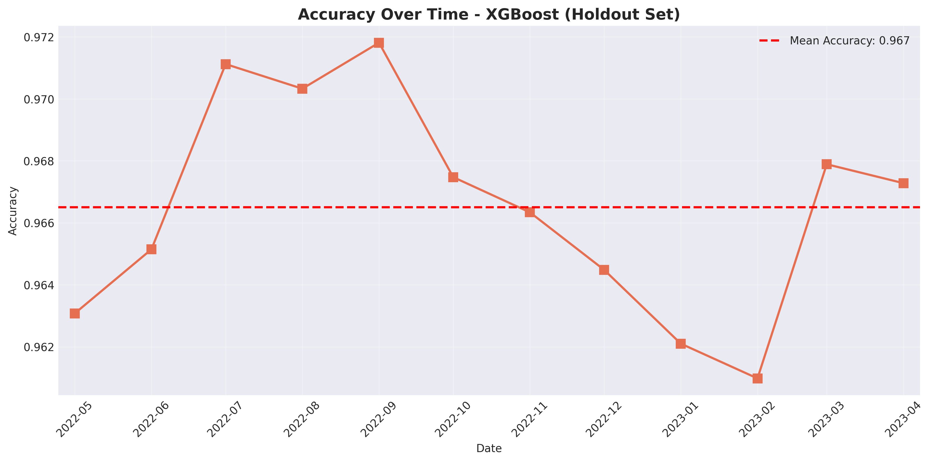
Model Accuracy (by Date_ym)
In evaluation, following the best model XGBoost, the highest AUC is over 0.72 in September 2022, while the lowest AUC is below 0.68 in October 2022.
In evaluation, following the best model XGBoost, the most accuracy is nearly 0.972 in September 2022, while the least AUC is about 0.961 in February 2023.
There is a difference between the lowest rate in different time due to its imbalance dataset.

Slide 8
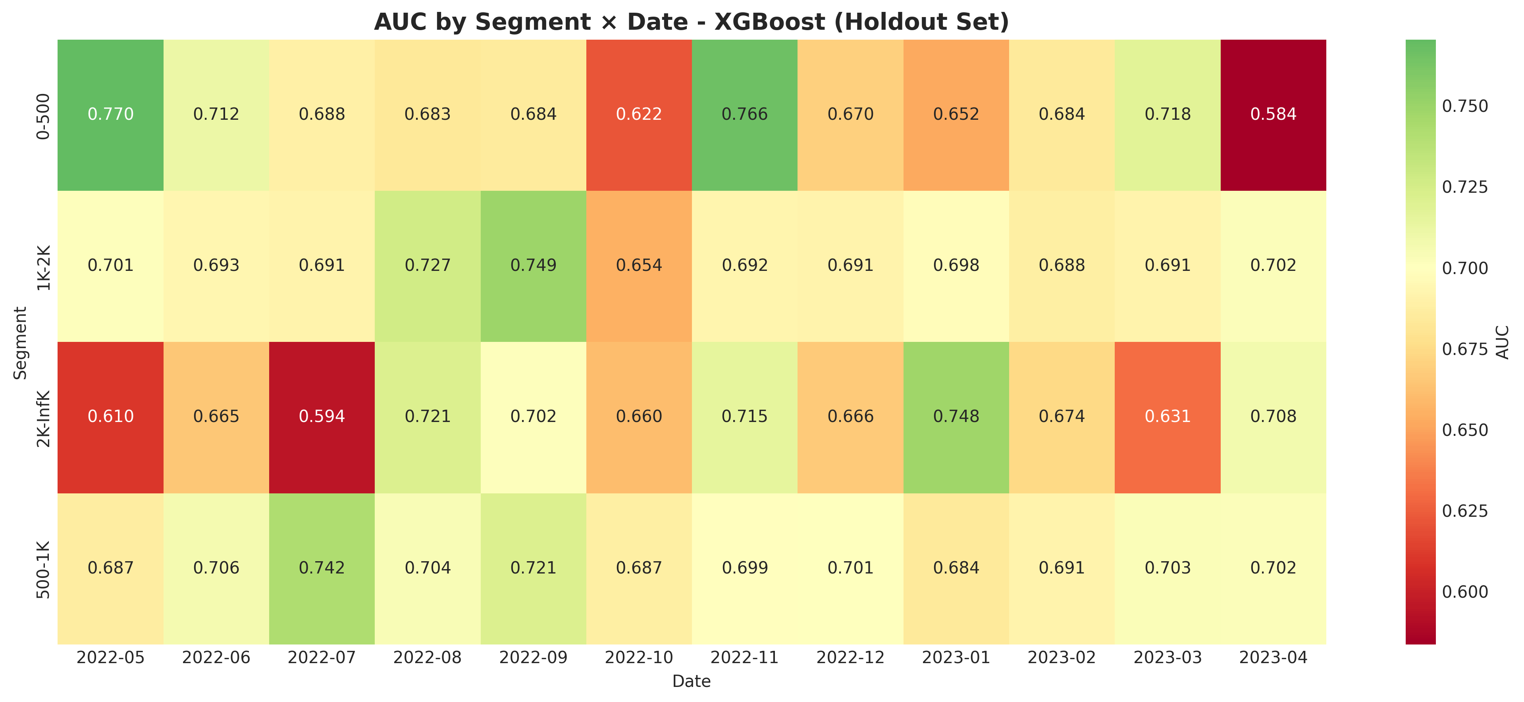
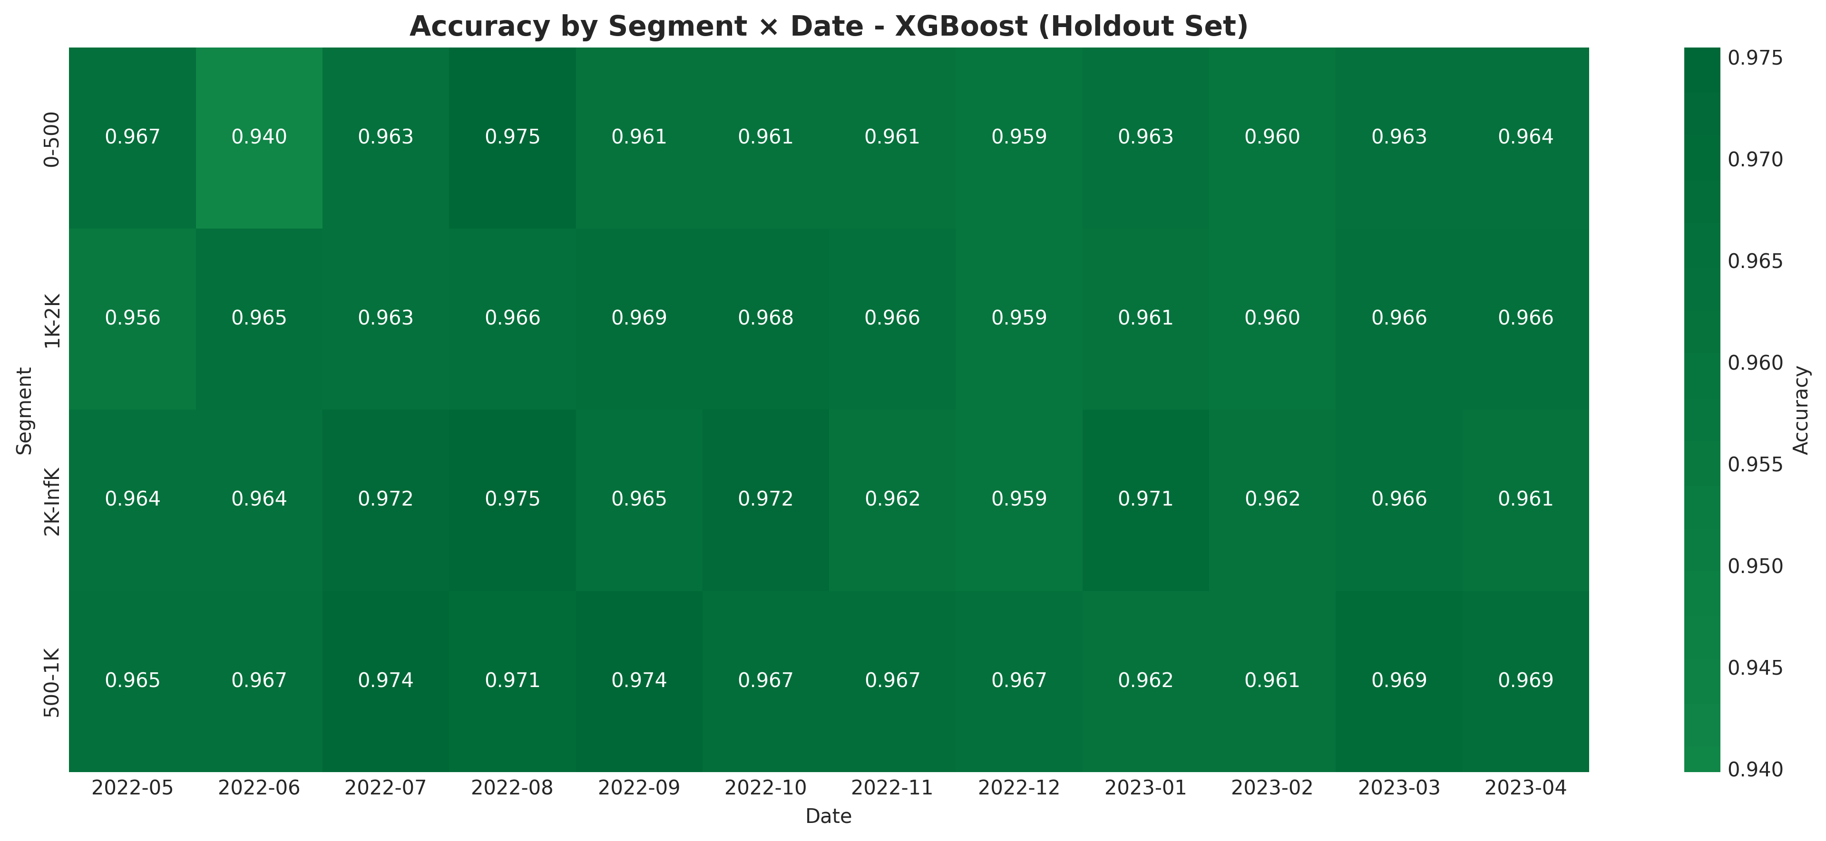
Model Accuracy (by Segment x Date_ym)
In evaluation, following the best model XGBoost, the highest AUC (by Segment x Date_ym) is 0.77 with 0-500 in November 2022, while the lowest AUC (by Segment x Date_ym) is 0.58 with 0-500 in April 2023.
Due to the imbalance dataset, accuracy metrics is overfitting (by Segment x Date_ym).

Slide 9
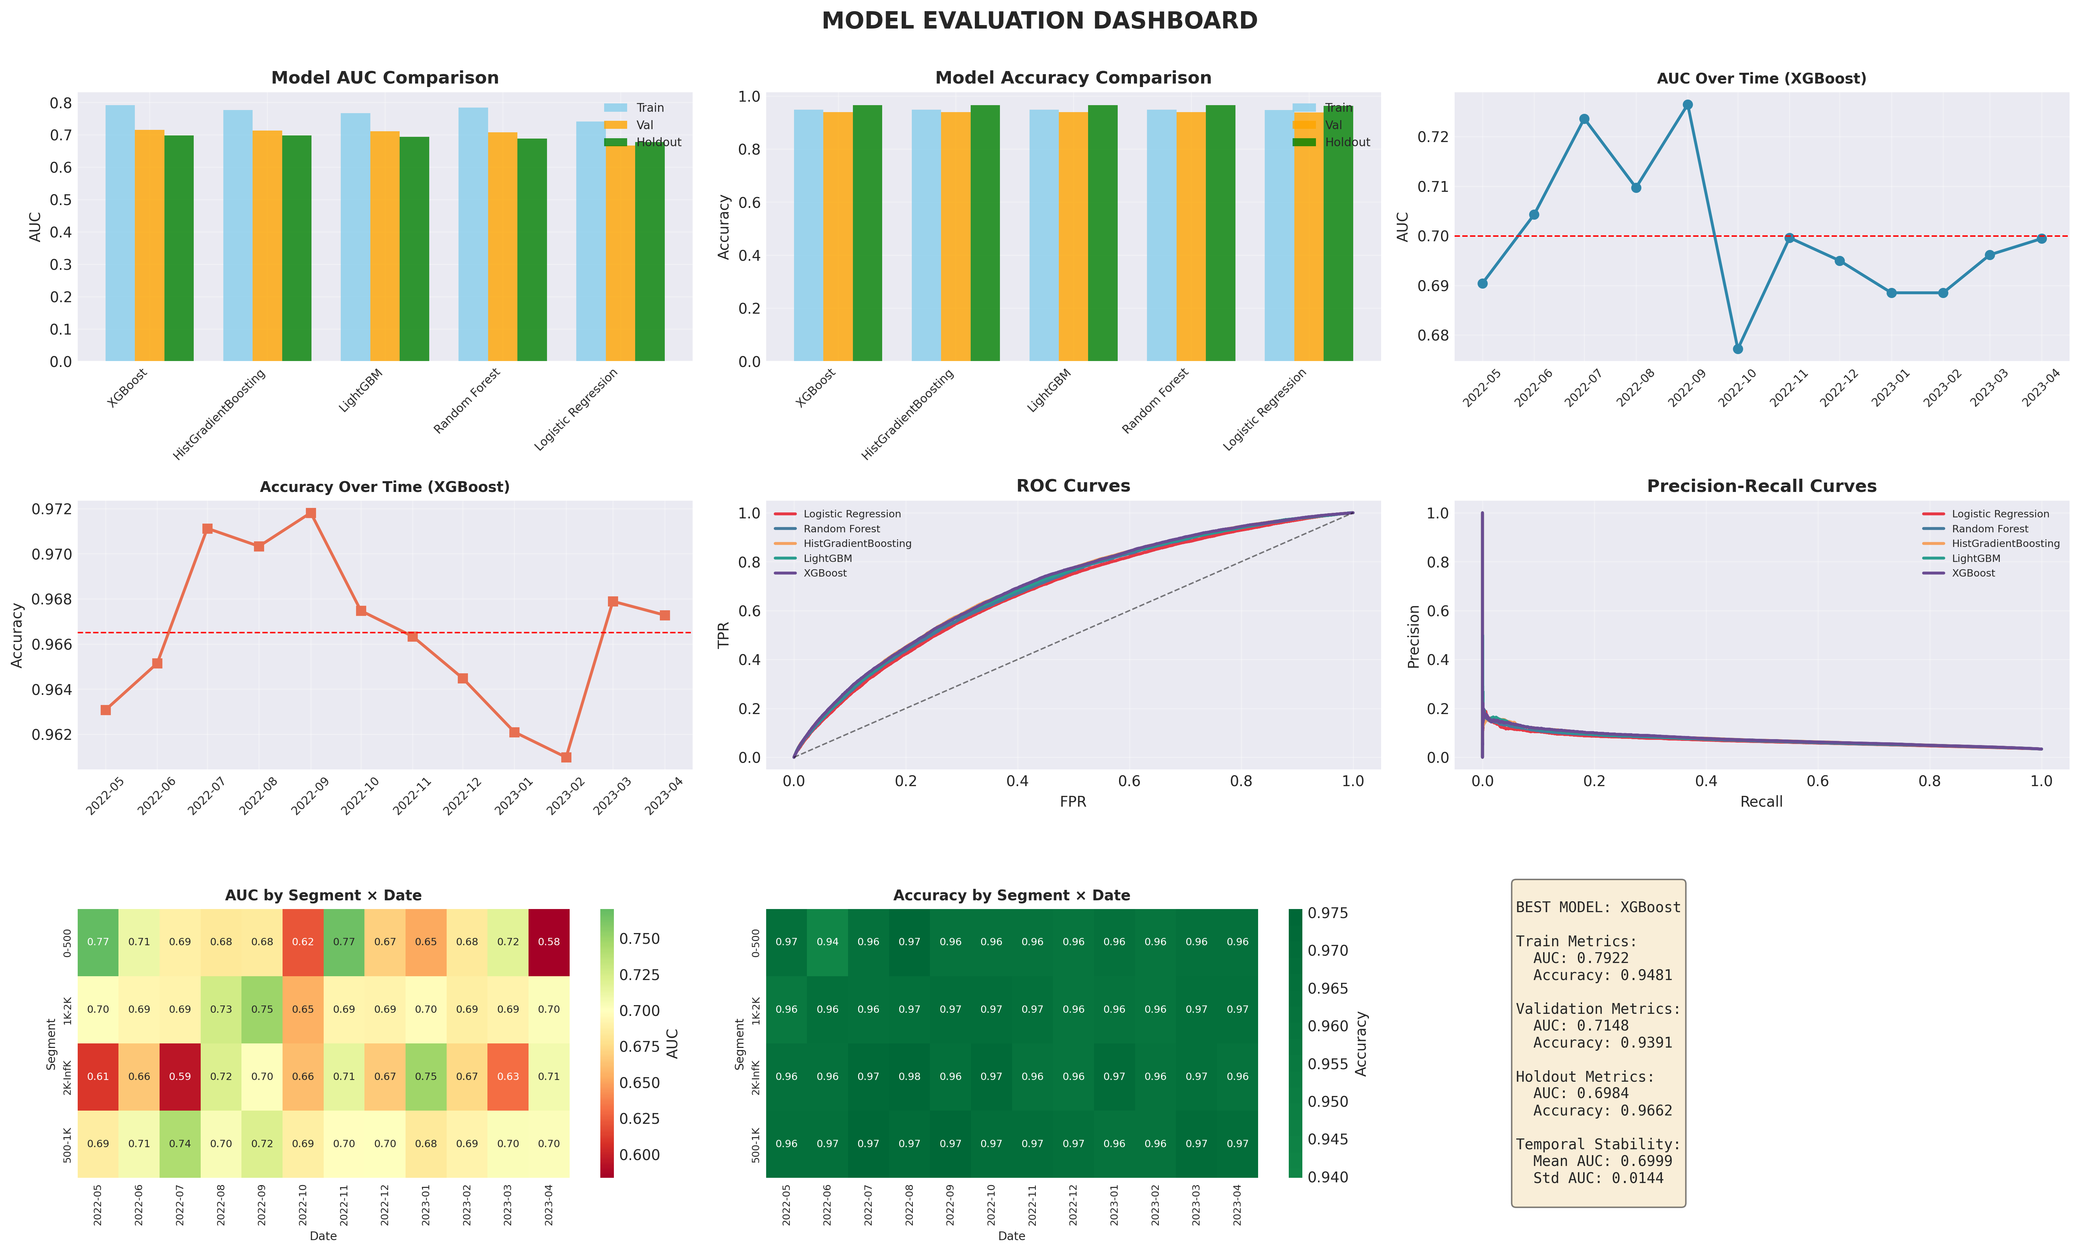
Model Dashboard

Slide 10
CONCLUSION
This approach is a multi-model, time-aware binary classification pipeline. It combines:
  Gradient boosting models for high predictive performance
  Linear model baseline for interpretability
  Temporal and segment evaluation for stability and reliability
It’s a structured pipeline: data loading and merging → feature engineering → train/validation/test split → model definitions (5 models: LG, RF, HGB, LGBM, XGB) → model training → best model selection → hold-out set evaluation → metrics table → temporal evaluation (by Date_ym) → Segment x Date_ym evaluation → visualization (individual plots) & dashboard → final summary.

